Slide 1
Internetworking
Outline
  Best Effort Service Model
  Global Addressing Scheme

Slide 2
IP Internet
Concatenation of Networks
Protocol Stack
Network 1 (Ethernet)
H7
R3
H8
H1
H2
H3
Network 4
Network 2 (Ethernet)
(point-to-point)
R1
R2
H4
Network 3 (FDDI)
H5
H6
H1
H8
TCP
R1
R2
R3
TCP
IP
IP
IP
IP
IP
ETH
ETH
FDDI
FDDI
PPP
PPP
ETH
ETH

Slide 3
Service Model
Connectionless (datagram-based)
Best-effort delivery (unreliable service)
  packets are lost
  packets are delivered out of order
  duplicate copies of a packet are delivered
  packets can be delayed for a long time
Datagram format
0
4
8
16
19
31
V
ersion
HLen
TOS
Length
Ident
Flags
Offset
TTL
Protocol
Checksum
SourceAddr
DestinationAddr
Options (variable)
Pad
(variable)
Data

Slide 4
Fragmentation and Reassembly
Each network has some MTU
Strategy
  fragment when necessary (MTU < Datagram)
  try to avoid fragmentation at source host
  re-fragmentation is possible
  fragments are self-contained datagrams
  use CS-PDU (not cells) for ATM
  delay reassembly until destination host
  do not recover from lost fragments

Slide 5
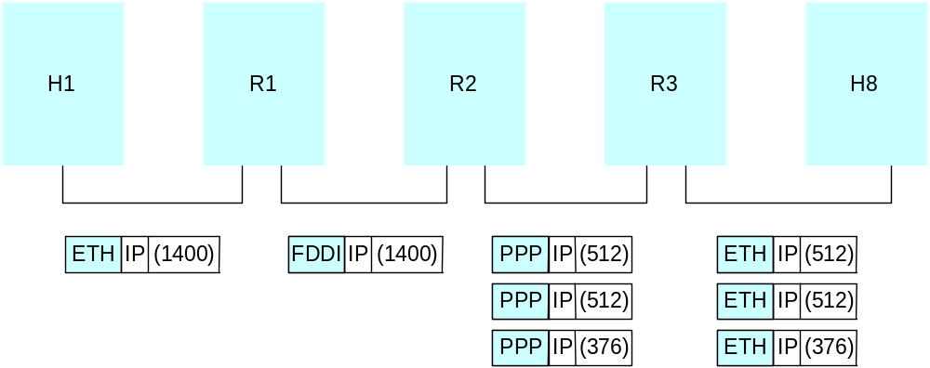
Example
Start of header
Ident
= x
0
Offset
= 0
Rest of header
1400 data bytes
Start of header
Ident
= x
1
Offset
= 0
Rest of header
512 data bytes
Start of header
Ident
= x
1
Offset
= 512
Rest of header
512 data bytes
Start of header
Ident
= x
0
Offset
= 1024
Rest of header
376 data bytes

Slide 6
Global Addresses
Properties
  globally unique
  hierarchical: network + host
Dot Notation
  10.3.2.4
  128.96.33.81
  192.12.69.77
7
24
A:
0
Network
Host
14
16
B:
1
0
Network
Host
21
8
C:
1
1
0
Network
Host

Slide 7
Datagram Forwarding
Strategy
  every datagram contains destination’s address
  if directly connected to destination network, then forward to host
  if not directly connected to destination network, then forward to some router
  forwarding table maps network number into next hop
  each host has a default router
  each router maintains a forwarding table
Example (R2) Network Number Next Hop
1 R3
2 R1
3 interface 1
4 interface 0

Slide 8
Address Translation
Map IP addresses into physical addresses
  destination host
  next hop router
Techniques
  encode physical address in host part of IP address
  table-based
ARP
  table of IP to physical address bindings
  broadcast request if IP address not in table
  target machine responds with its physical address
  table entries are discarded if not refreshed

Slide 9
ARP Details
Request Format
  HardwareType: type of physical network (e.g., Ethernet)
  ProtocolType: type of higher layer protocol (e.g., IP)
  HLEN & PLEN: length of physical and protocol addresses
  Operation: request or response
  Source/Target-Physical/Protocol addresses
Notes
  table entries timeout in about 10 minutes
  update table with source when you are the target
  update table if already have an entry
  do not refresh table entries upon reference

Slide 10
ARP Packet Format
0
8
16
31
Hardware type = 1
ProtocolT
ype = 0x0800
HLen = 48
PLen = 32
Operation
SourceHardwareAddr (bytes 0
–
3)
SourceHardwareAddr (bytes 4
–
5)
SourceProtocolAddr (bytes 0
–
1)
SourceProtocolAddr (bytes 2
–
3)
T
argetHardwareAddr (bytes 0
–
1)
T
argetHardwareAddr (bytes 2
–
5)
T
argetProtocolAddr (bytes 0
–
3)

Slide 11
Internet Control Message Protocol (ICMP)
Echo (ping)
Redirect (from router to source host)
Destination unreachable (protocol, port, or host)
TTL exceeded (so datagrams don’t cycle forever)
Checksum failed
Reassembly failed
Cannot fragment

